Slide 1
TOUCH SCREEN TECHNOLOGY
Presented By
Sandeep Reddy Baddam
Roll no.100911862006

Slide 2
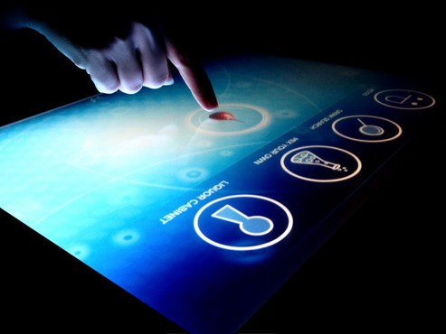
TOUCH SCREEN TECHNOLOGY

Slide 3
OVERVIEW
Introduction
History
Components
Applications
Advantages & Disadvantages

Slide 4
Introduction
A touch screen is an electronic visual display that can detect the presence and location of a touch within the display area.
Touch screen can also sense other passive objects such as stylus.
Touch screen technology is becoming a part of our everyday lives now.

Slide 5
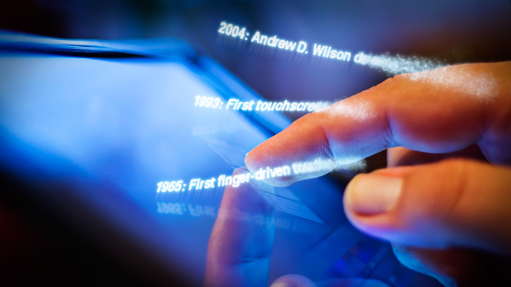
History
Invented by E.A. Johnson (Royal Radar Est.) around 1965 for air traffic control
HP-150 home computer using infrared technology in 1983
1993 Apple’s Newton and IBM’s Simon
2002 Microsoft’s Windows XP Tablet
2007 Apple’s iPhone (Multi-touch)

Slide 6
How Does a Touch screen Work?
A basic touchscreen has three main components:
1 Touch sensor;
2 Controller;
3 Software driver.
The touchscreen is an input device, so it needs to be combined with a display and a PC or other device to make a complete touch input system.

Slide 7
Touch sensor
A touch screen sensor is a clear glass panel with a touch response area.
The touch sensor is placed over a display screen so that the responsive area of the panel covers the viewable area of the screen.

Slide 8
Controller
The controller connect between the touch sensor and the PC.
Take information from the touch sensor and translate it into information that PC can understand.

Slide 9
Software driver
The driver allow the touch screen and computer to work together
This makes touching the screen as same as clicking the your mouse at the same location on the screen.

Slide 10
Touch Screen Technology
Four different technologies used to make touch screens today:
Resistive
Capacitive
Surface Acoustic Wave (SAW)
Infrared LED or Optical

Slide 11
Resistive Touch Screens
Two layers of conductive material
Touch creates contact between resistive layers completing circuit
Voltage in circuit changes based on position
Controller determines location based on voltages
Any material can trigger sensors

Slide 12
Capacitive Touch Screens
Glass panel with conductive layer (Indium Tin Oxide)
Small amount of voltage applied to four corners of touch screen

Slide 13
Surface Acoustic Wave Touch Screens
Surface consists of glass overlay with transmitting and receiving transducers
Electrical signals sent to the transmitting transducers converts to ultrasonic waves
Waves are directed across screen by reflectors then directed to receiving transducers
When finger touches screen it absorbs waves

Slide 14
Infrared/Optical Touch Screens
Uses infrared LEDs and matching photodetectors
Touching screen interrupts LEDs
Cameras detect reflected LED caused by touch
Controller able to calculate coordinates from camera data

Slide 15
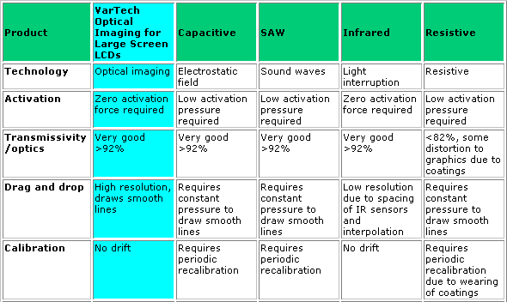
COMPARISION

Slide 16
Applications
ATMS
DUAL TOUCH SCREEN LAPTOPS.
SMART PHONES,IPAD
GROCERY STORES.
MUSEUMS.
CORPORATE INFORMATION
Interactive Kiosks and learning stations
Digital Camera

Slide 17
ADVANTAGES
DISADVANTAGES
User friendly
Fast response
Error free input
Use finger , fingernail , gloved hands , stylus or any soft tip pointer
Easy to clean
Does not interfere mouse and keyboard
Make computing easy , powerful and fun
It benefits children
Finger stress
Fingerprints
screen has to be really big not to miss
things when pressing them with your finger
big screen leads to low battery life
touch screen means screen can’t be read too well in direct sunlight as it applies an additional not 100% transparent
Fatigue

Slide 18
Conclusion
Designers are trying to use touch screen to simplify input commands
Today , touch screen has becomes adopted by computers users of all abilities because it is simple, fast and innovative.
In future there is no usage of mouse and keyboards as they will be replaced by touch screen.

Slide 19
Any Question ????

Slide 20
Thank You

