Slide 1
Wi-Fi Technology
Prepared by : G. Praveen Kumar
Roll No:1009-11-862-028
M.C.A III Year II sem

Slide 2
Outlines
Introduction
What is Wi-Fi ?
Wi-Fi Standards
Hotspots
Wi-Fi Network Elements
How a Wi-Fi Network Works
Advantages and Limitations of Wi-Fi
Wi-Fi Security
Conclusion
The Future of Wi-Fi

Slide 3
Introduction
Imagine working on your laptop or checking e-mail from anywhere in your home.
Imagine being able to connect to your office network from an airport or coffee shop.
Now , imagine doing all these
things easily and quickly, without
worrying about finding a wired
network connection.
That is Wi-Fi !

Slide 4
What is Wi-Fi?
Wi-Fi (Wireless Fidelity) is a generic term that refers to the IEEE 802.11 communications standard for Wireless Local Area Networks (WLANs).
Wireless Technology is an alternative to Wired Technology, which is commonly used, for connecting devices in wireless using radio waves.
Allows us to access the Internet while on the move, we can remain online while moving from one area to another, without a disconnection or loss in coverage.

Slide 5
IEEE 802.11 standard
In 1997, the Institute of Electrical and Electronic Engineers (IEEE) drafted the 802.11 standard for wireless local area networking.
In 1999, networking hardware companies accepted the standard and began manufacturing products using the 802.11b protocol which operated in the 2.4 GHz range and was capable of transmitting at speeds of 11 Mbps.
The 802.11a protocol was also released in 1999, operating at 5 GHz with transmissions speeds of 54 Mbps, but its cost was high.

Slide 6
IEEE 802.11 standard (cont.)
Network standard | Maximum Speed (Mbps) | Range (feet) | Frequency (GHz) | Power drain | Cost
802.11b | 11 | 100-150 | 2.4 | Moderate | Low
802.11a | 54 | 60-100 | 5 | High | High
802.11g | 54 | 150-250 | 2.4 | Moderate | Moderate
802.11n | 200 | Up to 300 feet | 2.4 & 5 | Moderate | Moderate

Slide 7
Hotspot
A Hotspot is any location where Wi-Fi
Hotspots are equipped with a Broadband Internet connection, and one or more Access Points that allow users to access the Internet wirelessly.
Hotspots can be setup in any public location that can support an Internet connection. All the locations discussed below are examples of Hotspots.
What is a Hotspot ?
network access is made publicly available.

Slide 8
Wi-Fi Hotspot Locations
Airports
Hotels & Resorts
Restaurants
Coffee Shops
Bookstores
Shopping Malls
There are several online services
allow you find hotspot locations.

Slide 9
Elements of a Wi-Fi Network
Access Point (AP) - The AP is a wireless LAN transceiver or “base station” that can connect one or many wireless devices in the same time to the Internet.
Safeguards - Firewalls and anti-virus software protect networks from unauthorized users and keep information secure.
Wi-Fi cards (Adapters) - They accept the wireless signal and relay information. They can be internal and external.

Slide 10
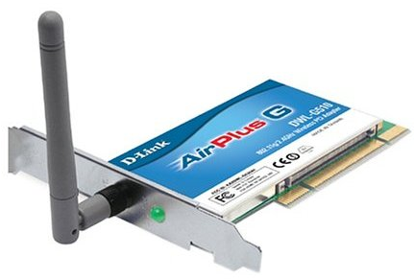
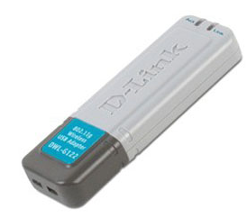
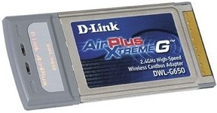
PCI and USB adapters
For Desktop For Laptop
PCI adapter USB adapter
PCMCIA adapter
(Internal) (External)

Slide 11
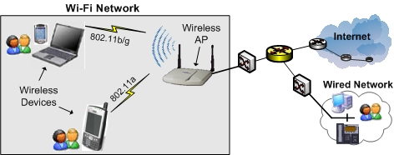
How a Wi-Fi Network Works ?
A Wi-Fi connection works through a transmitting antenna, which is usually connected to a cable Internet connection. The antenna on the router will then beam radio signals through a specific range. Another antenna, which is on the laptop or personal computer, receives the signal.

Slide 12
Advantages of Wi-Fi
No Wires - A truly wireless networking solution.
No Waiting - Fast, easy deployments.
No Worries - A wireless networking system that is secure, easy to manage, and built to grow with you.
Ease of Installation - Quick, easy setup.
Fast data transfer rates

Slide 13
Limitations of Wi-Fi
Limited range
Data security risks :a huge challenge for Wi-Fi networks.
Interference from other devices : such as telephones, microwave ovens.
High power consumption :making battery life and heat a concern .

Slide 14
Basic Wi-Fi Security Techniques
WEP(Wired Equivalent Privacy) : The original encryption technique specified by the IEEE 802.11 standard.
WPA(Wi-Fi Protected Access ): A new standard that provides improved encryption security over WEP.
WPA2 : is an improved version of WPA that uses Advanced Encryption Standard (AES) technology.

Slide 15
Basic Wi-Fi Security Techniques(cont.)
Securing Method | Encryption Type Used | Security Level | Notes
WEP | RC4 encryption algorithm | Low | No longer used; it is can be hacked easily
WPA | TKIP Protocol | High | provides improved encryption security over WEP
WPA2 | CCMP Protocol | Very High | An improved version of WPA that uses Advanced Encryption Standard

Slide 16
Conclusion
Wi-Fi is a simple, cost-effective way to connect to the Internet, without the need to physically connecting wires.
In 1997 IEEE drafted the 802.11 standard for wireless local area networking.
Hotspot is a geographic area setup in any public location, and has a readily accessible wireless network.
Security is a huge challenge for Wi-Fi Networks, many Security Techniques are used to improve it.
Wi-Fi Networks have a several limitations that should be concerned.

Slide 17
THANK YOU

