Slide 1
NEAR FIELD COMMUNICATION
Submitted By:
A.Anjaneyulu
1009-11-862-008

Slide 2
INTRODUCTION
Near Field Communication (NFC) is based on a short-range wireless connectivity, designed for simple and safe interaction between electronic devices. It is easy to use wireless communication interface for last few centimetres. connection between two devices is established just by holding the devices close to each other or touch them together.
NFC IS AS EASY AS A TOUCH

Slide 3
HISTORY
NFC traces its roots back to Radio frequency identification(RFID).
RFID is the use of a wireless non-contact system that uses radio-frequency electromagnetic fields to transfer data from a tag attached to an object, for the purposes of automatic identification. Some tags require no battery and are powered and read at short ranges via magnetic fields (electromagnetic induction). Others use a local power source and emit radio waves at radio frequence. The tag contains electronically stored information which may be read from up to several meters away.
It was jointly developed by Sony and Philips.
2006-Nokia 6131 was the first NFC phone
2010-Samsung Nexus S: First Android NFC phone

Slide 4
WHAT IS NFC?
It is a wireless communication technology based upon 13.56 MHz. It is designed for read/write transactions with a very short range operating distances up to a few centimetres(less than 10cm)
It offers a baud rate of 106 kbps to 424kbps.
At a transaction only two participants can be involved - one transmitter (initiator) and one receiver (target).

Slide 5
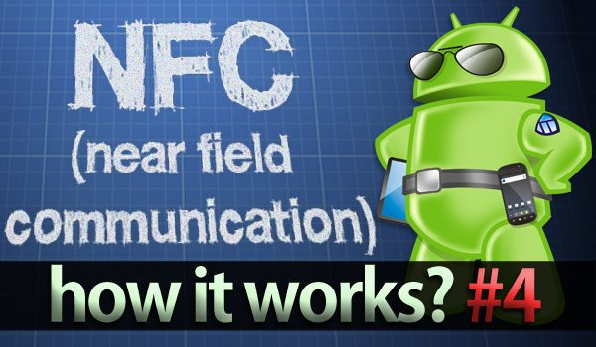
Near field communication builds on the RFID technology. It allows for two-way communication between devices at a very short range.

Slide 6
WORKING
Near-field communications (NFC) combines two established technologies: radio frequency identification (RFID) tags, which are tiny chips with built-in radios and wireless reader that picks up the signals from the radios. The reader when activated emits a short range radio signal that powers up a microchip on the tag, and allows for reading a small amount of data that can be stored on the tag.

Slide 7
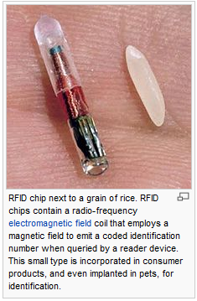
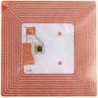
RFID OBJECT

Slide 8
COMMUNICATION MODES: ACTIVE AND PASSIVE
Active mode:
communication between two active devices(both initiator and target are powered devices).
In active mode both initiator and target are using their own generated RF field to enable the communication.
In active mode the data is sent using amplitude shift keying (ASK).

Slide 9
Passive mode:
Communication takes place between an active and a passive device.
Passive device has no battery and uses the RF field generated by the active device.
The Initiator device provides a carrier
The Target device answers by modulating existing field.
Target device act as a transponder

Slide 10
COMPARISON WITH BLUETOOTH AND INFRARED
The problem with infrared is the fact that a direct line of sight is required, which reacts sensitively to external influences such as light and reflecting objects.
The significant advantage over Bluetooth is the shorter set-up time. Instead of performing manual configurations to identify the other’s phone, the connection between two NFC devices is established at once (<0,1s). With less than 10 cm, NFC has the shortest range.

Slide 11
ADVANTAGES
Low cost, NFC has very fast and easy configuration and pairing.
Instant connection capability.
“Out of the box”
- No special software
- No manual configuration and settings
- No search and pair procedure
Intuitive
- User initiates the process
- Simple data acquisition just by touching
High level of flexibility and adaptability
- Read data from passive RFID tag

Slide 12
DISADVANTAGES
Not enough NFC enabled mobile devices on the market yet.
Security concerns
very less data transfer rate
range is very less

Slide 13
APPLICATIONS
Touch and Go: Applications such as access control or transport/event ticketing, where the user needs only to bring the device storing the ticket or access code close to the reader.
Touch and Confirm: Applications such as mobile payment where the user has to confirm the interaction by entering a password or just accepting the transaction.
Touch and Connect: Linking two NFC-enabled devices to enable peer to peer transfer of data such as downloading music, exchanging images or synchronizing address books.
Touch and Explore: NFC devices may offer more than one possible function. The consumer will be able to explore a device's capabilities to find out which functionalities and services are offered.

Slide 14
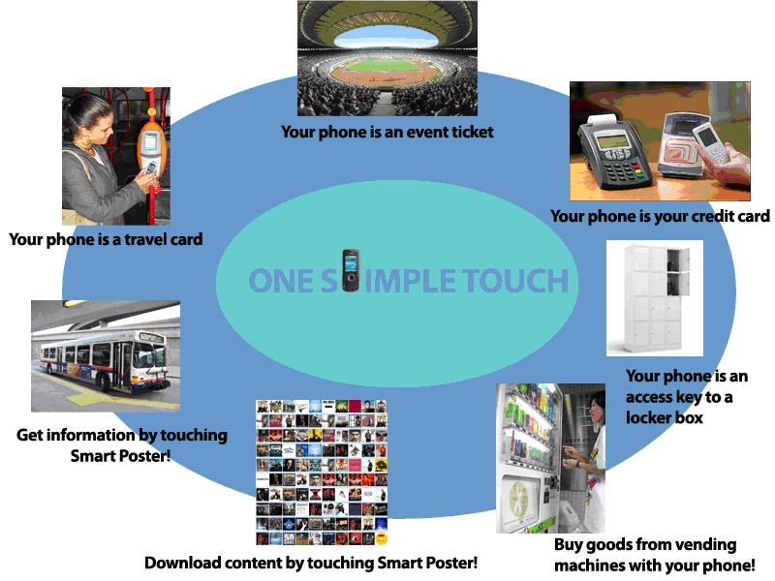

Slide 15
CONCLUSION
In summary, Near Field Communication is an efficient technology for communications with short ranges. It offers an intuitive and simple way to transfer data between electronic devices. A significant advantages of this technique is the compatibility with existing RFID infrastructures. Additionally, it would bring benefits to the setup of longer-range wireless technologies, such as Bluetooth ,Wifi .
NFC is a technology that makes peoples lives easier – easier to pay for goods and services, easier to use public transport, and easier to share data between devices

Slide 16
Thank you!

